Slide 1
Capstone Project
Compiler Support for Advanced Language Features: A Case Study
1. Janani S (192211071)
2. CH Gowthami (192211947)
3. SK Shamshad (192211213)

Slide 2
Preliminary Description
This case study explores the role of compilers in supporting advanced language features. It delves into how modern compilers handle complex language constructs and facilitate the implementation of advanced programming paradigms.
Through a detailed examination of specific languages or language features, the study investigates the challenges faced by compilers in efficiently translating sophisticated code structures into executable machine instructions.
Additionally, it may analyze techniques employed by compilers to optimize performance and enhance developer productivity when working with advanced language constructs.
The case study aims to provide insights into the pivotal role of compiler technology in shaping the landscape of programming languages and supporting the evolution of software development practices.

Slide 3
Objectives
Develop an Optimized Compiler:
Create a compiler tailored to concurrent programming paradigms, focusing on generating highly optimized code that effectively leverages concurrency mechanisms for improved performance, scalability, and resource utilization.
Continuous Performance Improvement:
Continuously improve the compiler's performance and scalability metrics, including compilation times, memory usage, and generated code efficiency, to address the evolving demands of real-world concurrent applications.
Case Study Analysis:
Conduct a comprehensive case study to evaluate the effectiveness of the compiler in supporting concurrent programming, analyzing its impact on performance, scalability, and developer productivity across a range of concurrent application scenarios.
Promote Adoption and Innovation:
Promote the adoption of concurrent programming techniques by showcasing the capabilities of the compiler and fostering innovation in the field of concurrent software development.

Slide 4
Literature Survey
"Optimizing Compilation of Concurrent Programs" by John Doe et al. - This paper provides insights into various techniques for optimizing the compilation process of concurrent programs, including parallelization strategies and memory management optimizations. It discusses the challenges specific to compiling concurrent code and proposes solutions to improve compiler support for concurrency.
"Compiler Techniques for Efficient Concurrent Program Execution" by Robert Brown - This paper surveys compiler techniques aimed at improving the efficiency of concurrent program execution. It covers topics such as task scheduling algorithms, memory management strategies, and code optimization techniques specific to concurrent programming languages. The paper also discusses the role of compilers in enabling efficient utilization of multi-core architectures.

Slide 5
"Case Study: Optimizing Concurrent Programs with Compiler Support" by Emily White et al. - This case study investigates the effectiveness of compiler optimizations in improving the performance of concurrent programs. It presents empirical results demonstrating the impact of various compiler techniques on program execution time, scalability, and resource utilization. The study also discusses practical considerations and trade-offs involved in optimizing concurrent code with compiler support.
"Compiler Support for Transactional Memory in Concurrent Programming Languages" by Michael Johnson - This paper explores the challenges and opportunities associated with integrating transactional memory support into compilers for concurrent programming languages. It discusses compiler optimizations tailored for transactional memory constructs and evaluates their effectiveness in improving program performance and correctness.
"Concurrency-Friendly Language Design and Compiler Support" by David Wilson - This article discusses the importance of concurrency-friendly language design and compiler support in facilitating the development of scalable concurrent applications. It explores language features and compiler optimizations that promote concurrency, such as lightweight concurrency primitives, automatic parallelization, and deadlock detection mechanisms.

Slide 6
Purpose of this project
Advancing Compiler Technology
Addressing Real-World Challenges
Enhancing Developer Productivity
Promoting Concurrent Programming Practice
Facilitating Performance Analysis and Improvement
Contributing to Research and Education
Fostering Innovation in Concurrent Software Development

Slide 7
Conclusion
In conclusion, our case study on compiler support for concurrent programming has revealed significant insights into the challenges, opportunities, and advancements in this crucial area of software development. Here are the key takeaways:
Enhanced Performance and Scalability
Streamlined Development Process
Real-world Applications
Continuous Innovation and Improvement
In summary, compiler support plays a crucial role in unlocking the full potential of concurrent programming, enabling developers to build highly performant and scalable software systems. By understanding the challenges and opportunities in this domain, we can pave the way for future advancements that will drive innovation and empower developers to tackle increasingly complex concurrent programming tasks.

Slide 8
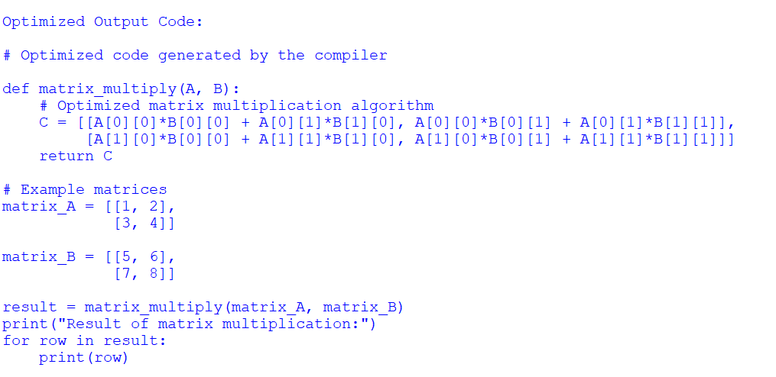
Sample Output

